Slide 1

IBM DATA SCIENCE CAPSTONE PROJECT
Battle of Restaurants in New York City’s Neighborhoods
#neighborhoodrecommender

Slide 2
INTRODUCTION
New York City is one of the most visited cities, full of vibrant international food scene, and ranked as the top cities for food [1]. This can be good and bad news for tourists as finding the right place to stay, close to restaurants with desired cuisines, is undoubtedly a huge challenge. Great food or restaurant is always one of the biggest factors in determining strategic location to stay for tourists.
Project objective
To provide recommendation to tourists in New York City with neighborhood clusters, categorised by top cuisines in the vicinity
The recommendation is to facilitate the tourists in choosing the best place to stay
The chosen scenario for this project is to recommend neighborhoods in Bronx, New York, to tourists who are looking for an area with specific cuisine such as Italian, Spanish etc.
Description of data
The following data is required to conduct the project analysis:
List of neighborhoods in Bronx, New York, including geo-coordinates:
source: https://cocl.us/new_york_dataset (stored in json format)
relevant information is extracted using python library json
Top venues in each neighborhood, focusing of restaurant categories:
data is extracted from Foursquare through an API using python library request
[1] https://www.travelandleisure.com/food-drink/worlds-best-cities-for-food

Slide 3
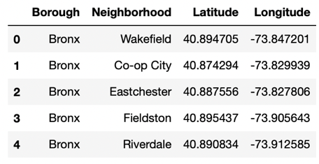
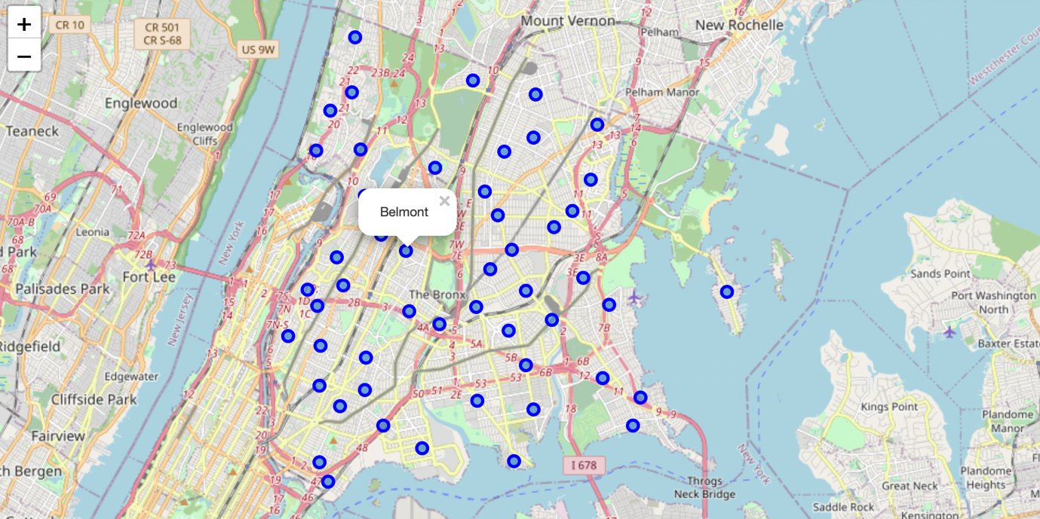
METHODOLOGY
1. Data preparation
→ Extract data from json file (json library)
→ Transform data into pandas dataframe
→ Visualise data on a map (folium library)
Top rows of neighborhoods with geo-coordinates
Map of neighborhoods in Bronx, New York

Slide 4
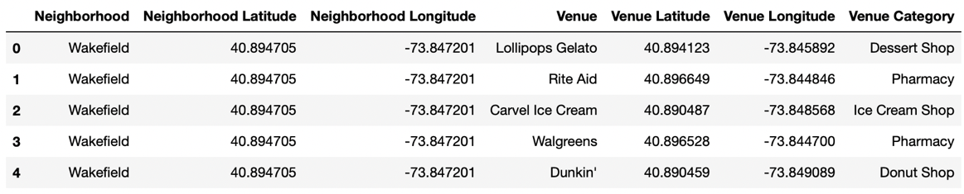
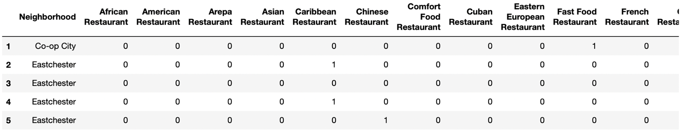
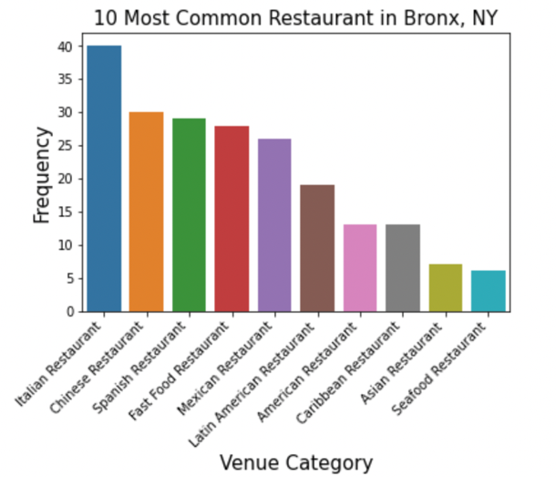
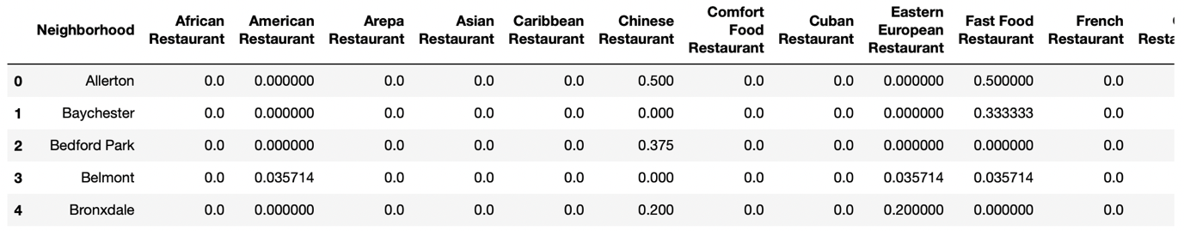
METHODOLOGY
2. Data exploration and manipulation
→ Obtain venues tagged to each neighborhood through Foursquare API*
→ Transform received data from json format to pandas dataframe
→ Plot 10 most common restaurant in the neighborhoods
→ Create pandas dataframe with dummy variables of restaurant venues using one-hot encoding (0/1)
→ Group the neighborhoods to show the mean frequency of occurrence in each restaurant category
Top rows of venues with geo-coordinates
Top rows of neighborhoods with dummy variables of restaurant category
Top rows of neighborhoods with mean frequency of restaurant category
*venues are collected with limit of 100 for each neighborhood, based on 500-metre radius from neighborhood geo-coordinates

Slide 5
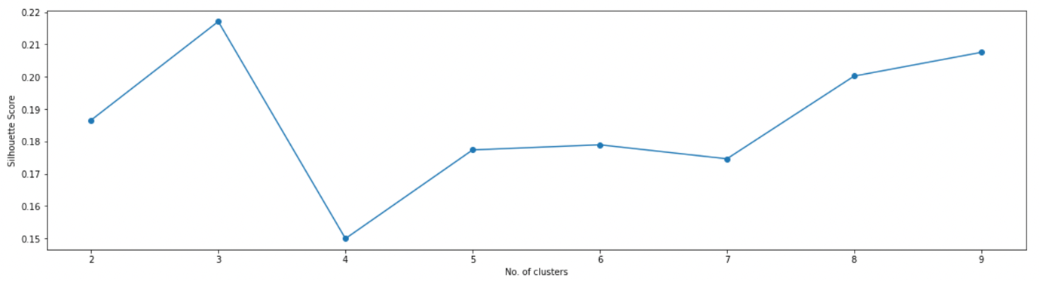
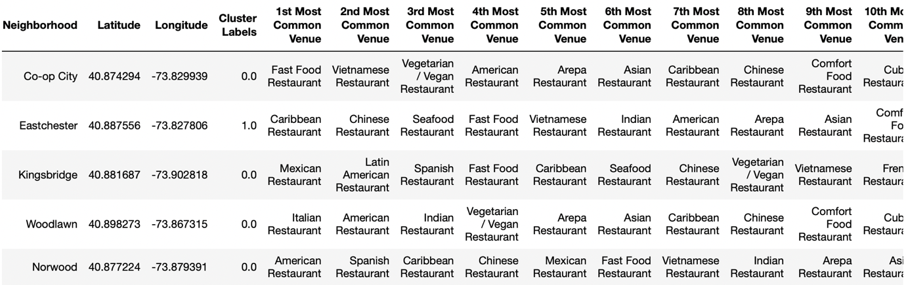
METHODOLOGY
3. Data clustering
→ Perform data clustering using K-means (scikit-learn library)
→ Pre-defined no. of clusters is based on optimal silhouette score
→ Create pandas dataframe that merges all information on neighborhood, geo-coordinates, cluster label and 10 most common restaurant venue
Line plot of silhouette score against no. of clusters
Top rows of neighborhoods with labelled clusters

Slide 6
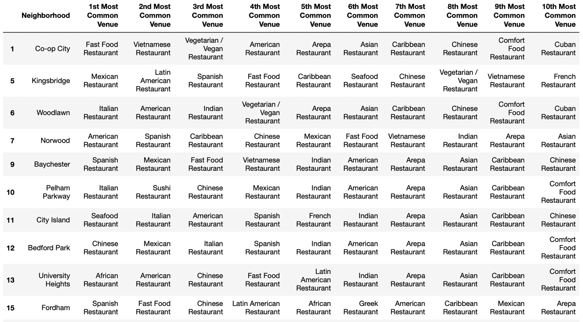
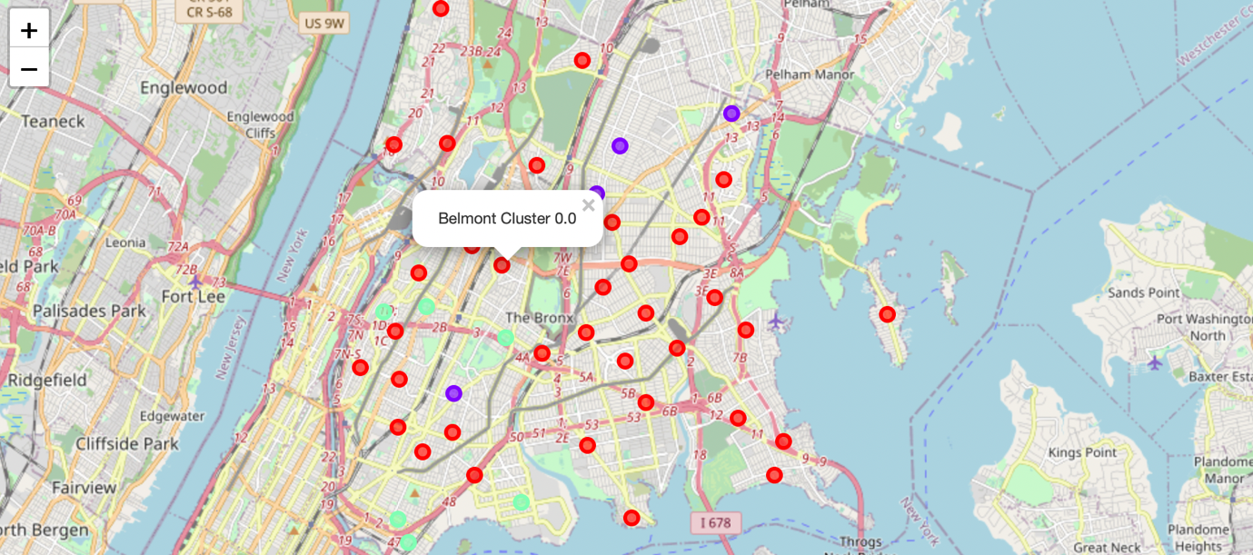
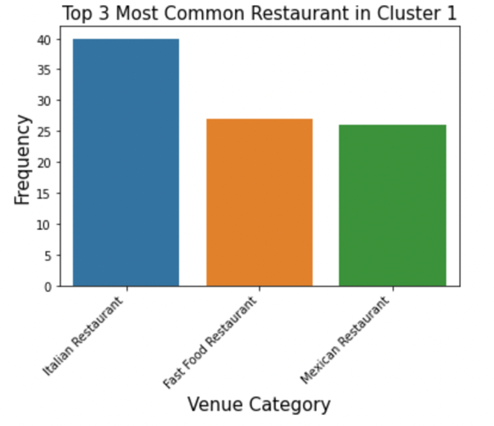
RESULTS
Top rows of neighborhoods in Cluster 1
Cluster 1 (red dot)
The biggest cluster, scattered all over Bronx, which indicates Italian, Fast Food and Mexican restaurants are well appreciated by a wide range of neighborhoods
Map of 3 clusters of neighborhoods in Bronx, NY

Slide 7
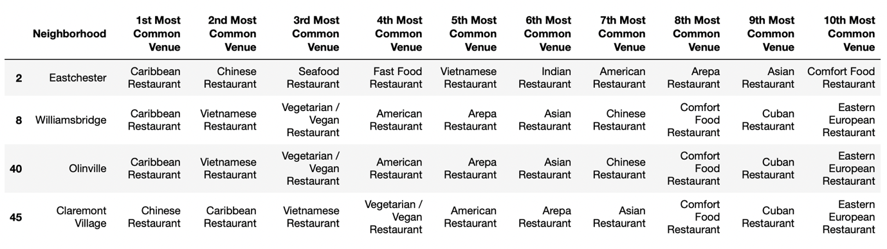
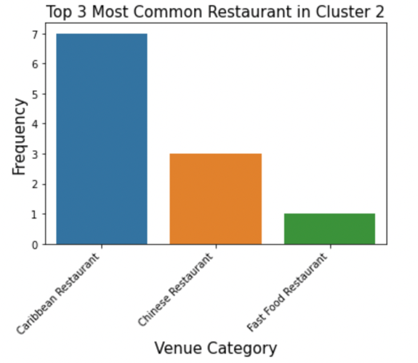
RESULTS
Cluster 2 (purple dot)
The second cluster is much smaller than the first cluster, and mostly located in the northern part of Bronx, with Caribbean and Chinese cuisines as the most popular in the area
List of neighborhoods in Cluster 2
Map of 3 clusters of neighborhoods in Bronx, NY

Slide 8
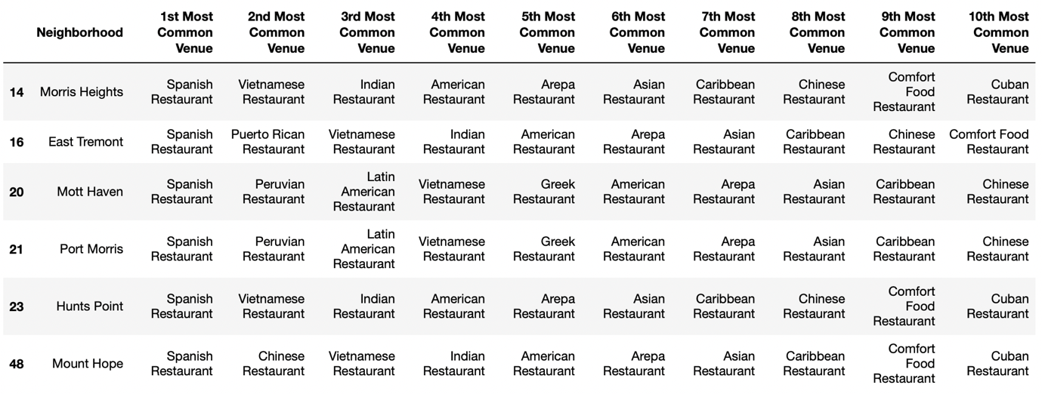
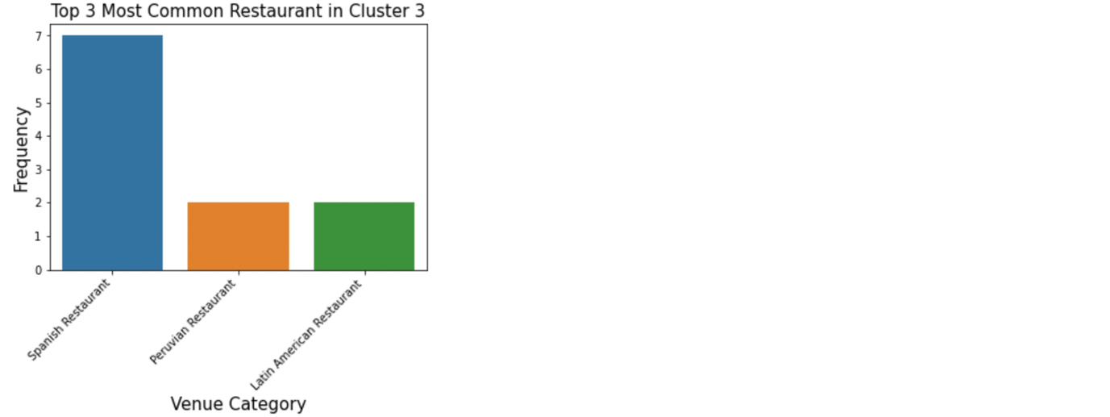
RESULTS
Cluster 3 (green dot)
The third cluster is slightly larger than the second cluster, and generally located in the opposite area ie. southern part of Bronx, with Spanish restaurants being the people’s favourite who stay in the neighborhoods
List of neighborhoods in Cluster 3
Map of 3 clusters of neighborhoods in Bronx, NY

Slide 9





RECOMMENDATION
Similar way of recommendation to tourists, regardless of preferred cuisines or neighborhoods clusters
Craving for Italian and Mexican cuisines, Cluster 1 neighborhoods is ideal for staycation
Fans of Caribbean, Chinese or Spanish food, the other two clusters are more suitable, depending on which cuisines
The role of this recommendation is to facilitate tourists in choosing the right location to stay, mainly based on food factor
Highlight:
The model can also be implemented on other boroughs in New York City, as well as any city in the world, provided there is sufficient dataset from Foursquare for clustering modeling
Cluster 1
Mexican
Italian
and more…
Cluster 3
Cluster 2
Caribbean
Spanish
and more…
Chinese
and more…

Slide 10
THANK YOU FOR YOUR PASSION!
Full report and Jupyter notebook are available on github link:
https://github.com/acapamin/IBM-Capstone-Project/blob/main/Capstone%20Project%20Report.pdf
https://github.com/acapamin/IBM-Capstone-Project/blob/main/Capstone%20Project%20Final.ipynb
#neighborhoodrecommender

